Slide 1
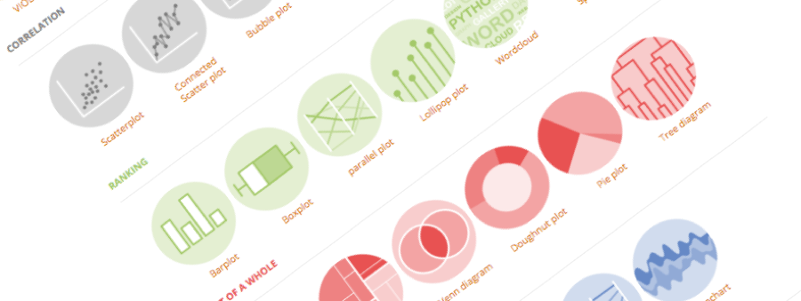

A classification of chart types based on data input format

Slide 2

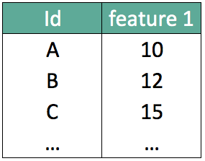
What should I do with my data ??

Slide 3
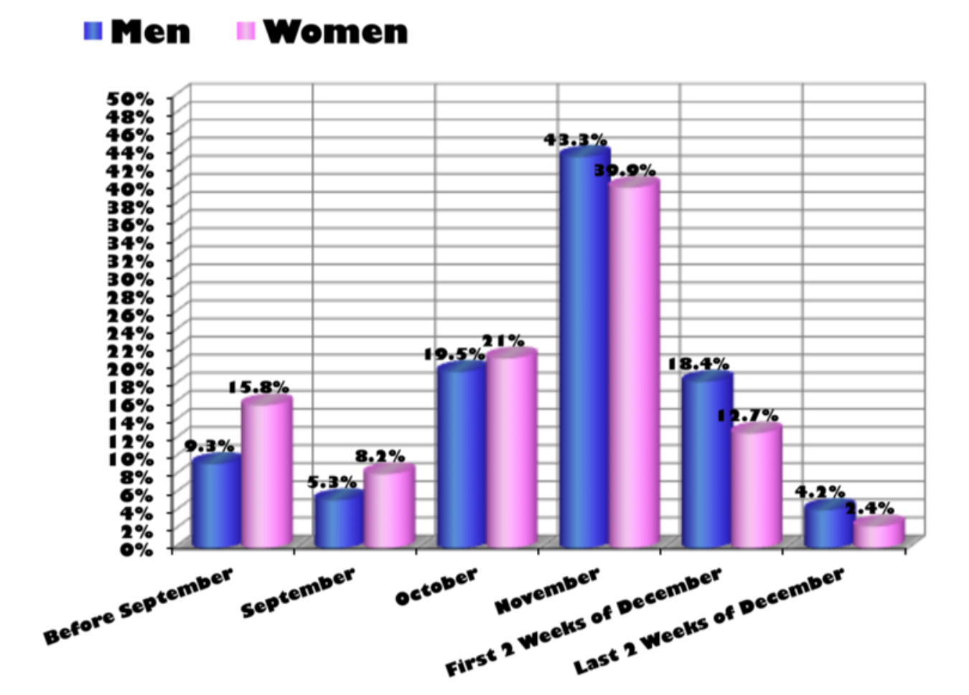
What about that?
Source: Storytelling with data by Cole Nussbaumer Knaflic

Slide 4
Looking for a chart for your data ?
What you can do
What you should do
What caveat to avoid
How to do it
Classification of data
Obvious example
Harder example
May be obvious for us, but actually most of the chart types are unknown!
→ final: show the poster
Depends on the story -> what message are you trying to convey
Depends on the data: possible to have same format, same question, but shape are different and don’t work
Showing something like 10 caveats, asking to people what’s wrong with it
Show the line with all existing tools
R – Python – D3 demo
4 parts of the talk

Slide 6
WHAT YOU CAN DO
A classification of chart types based on data input format

Slide 7
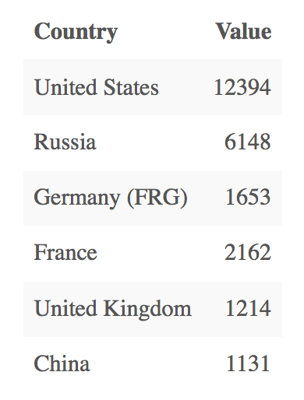
Who sells more weapons ?
?
Notes:
Very simple dataset,
-> What would you do ?

Slide 8
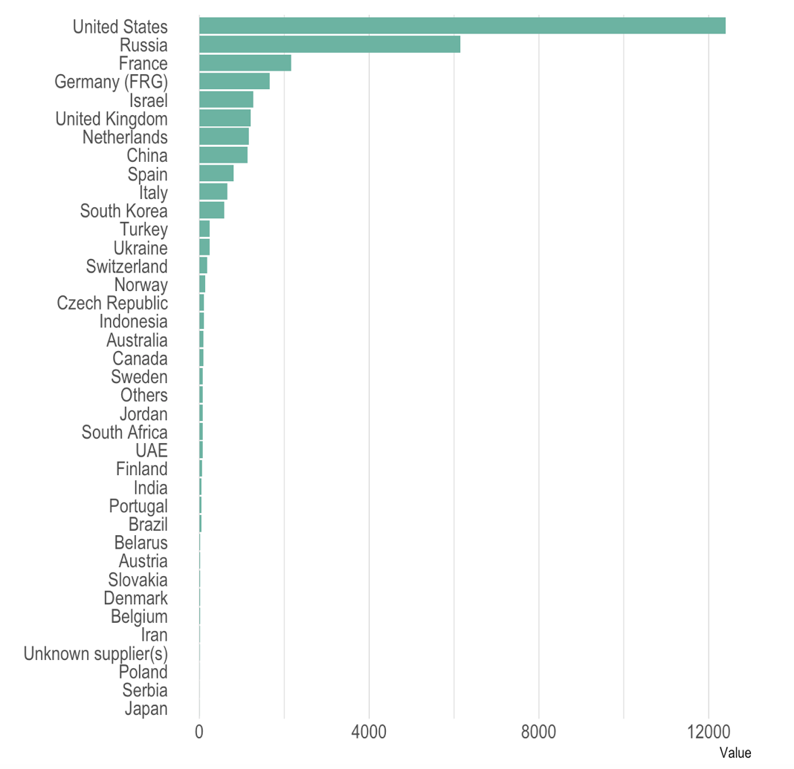
Who sells more weapons ?

Slide 9
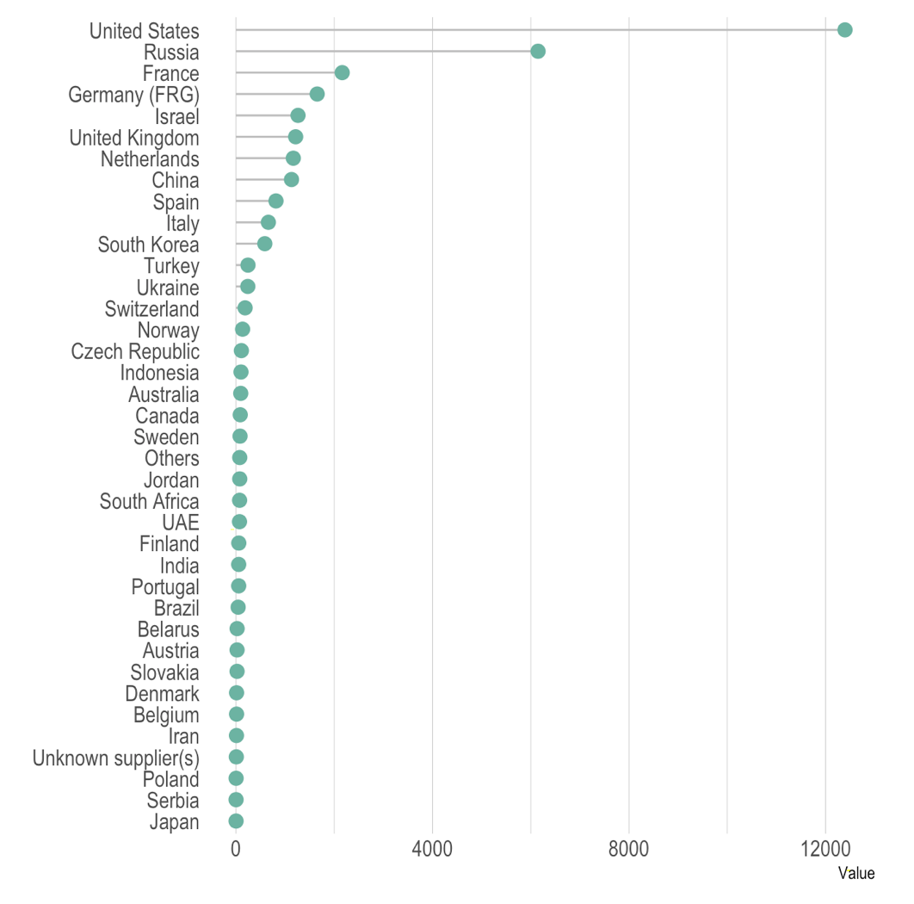
Who sells more weapons ?

Slide 10
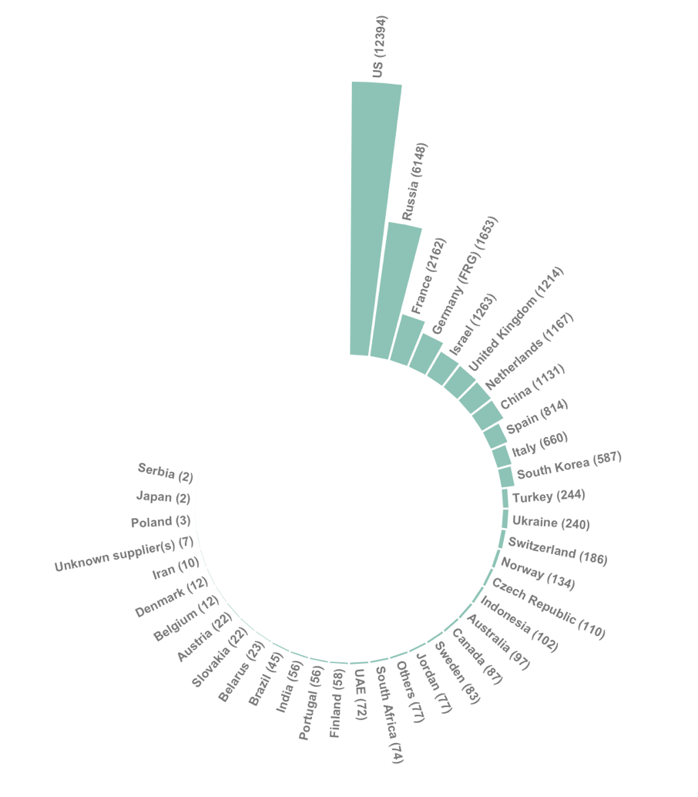
Who sells more weapons ?

Slide 11
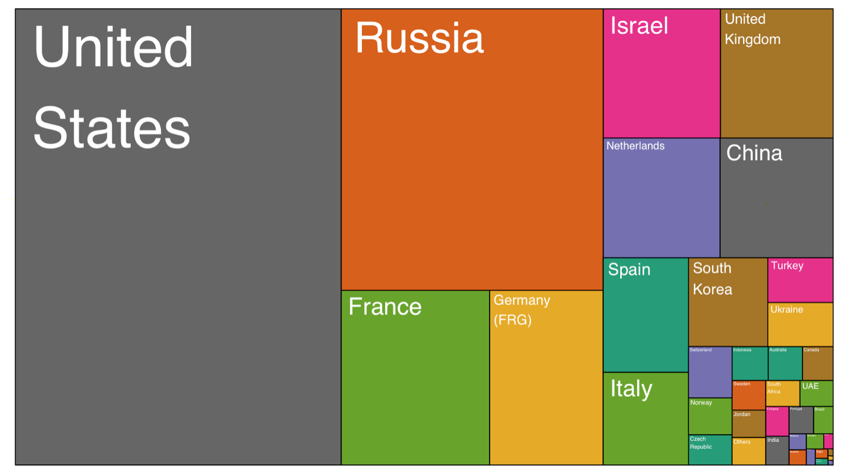
Who sells more weapons ?

Slide 12
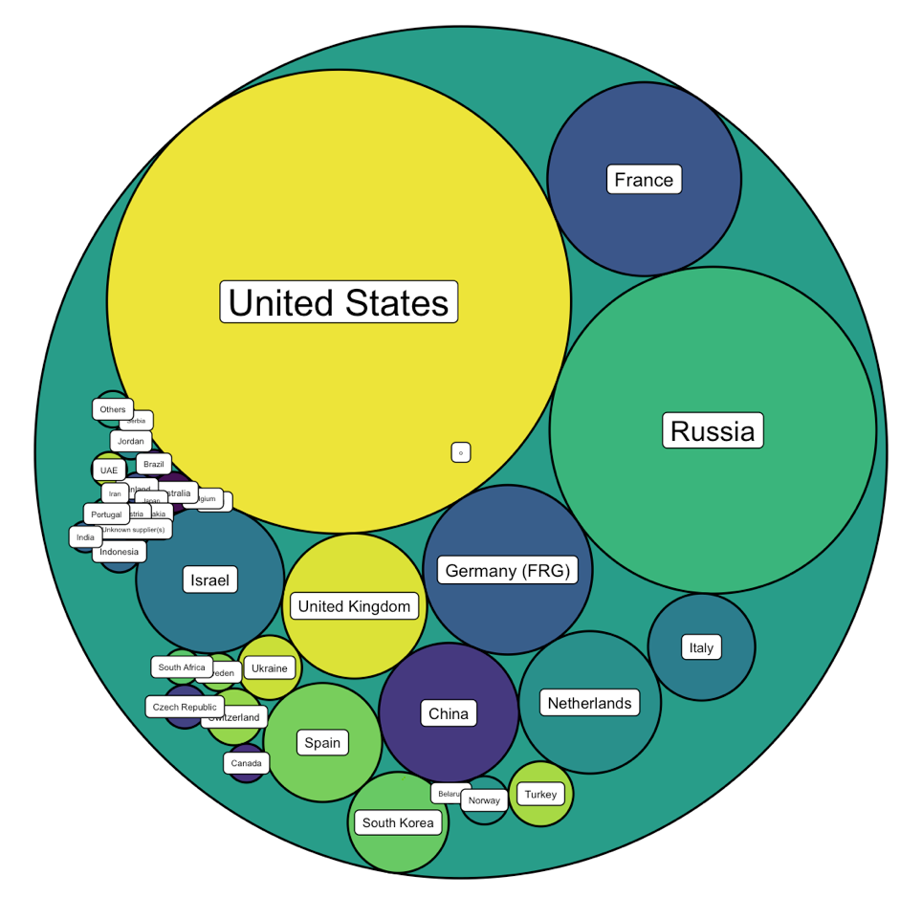
Who sells more weapons ?

Slide 13







Who sells more weapons ?

Slide 14
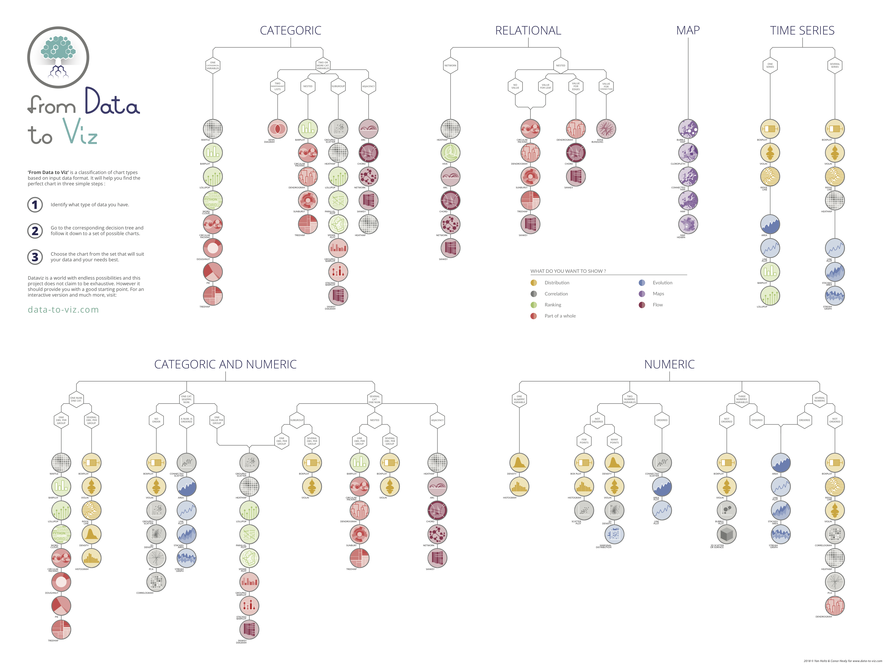

Slide 15
Take Home Message
Knowing the possibilities is the first step in chart choice
Not easy to know all the chart types
Hard to figure out options from a dataset

Slide 16
WHAT YOU SHOULD DO
About 20 examples of storytelling with data

Slide 17
Who’s reading ?
Interactive or Static?
Data itself
Chart Decision
Eye catching / accurate
Question
Exploratory vs Explanatory

Slide 20
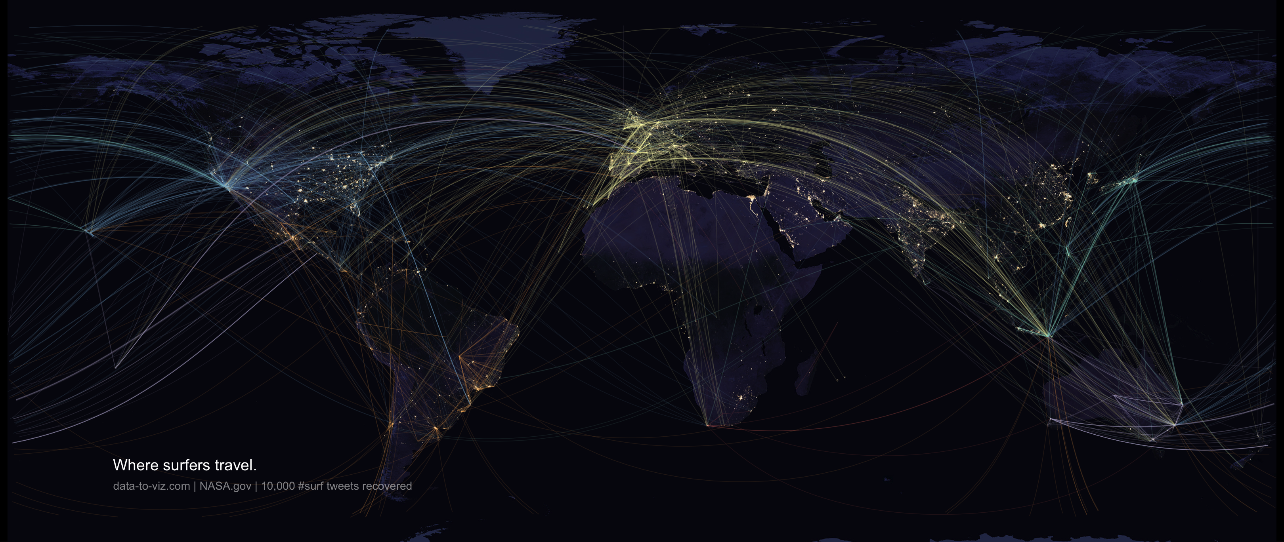

Slide 21
WHAT YOU SHOULD NOT DO
A gallery of most common caveats

Slide 22
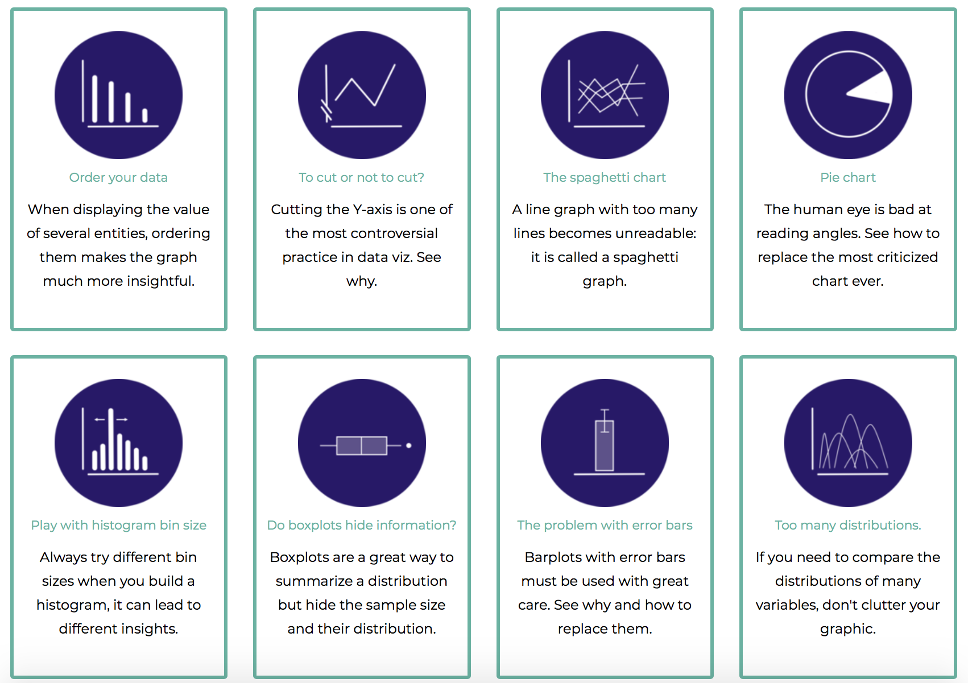

Slide 23
HOW TO DO IT
The R and Python graph galleries

Slide 24
Easy
Limited
Hard
Flexible

Slide 25

Data-to-viz.com
Thank you
Contribute
Github link
Talk link
Twitter link
Hire Me!

